Slide 1
SMART PARKING
Submitted By
KAVI BHARATH T
kavibharath06112002@gmail.com
auttrtkvl004(transfer student)
Department of Electronics and Communication Engineering Anna University Regional Campus Coimbatore​

Slide 2
LIST OF SENSORS
Active state conditions :
Ultrasonic sensor
Occupancy sessor
Video Camera
Passive state conditions :
RFID sensor
Entry and exit gate sensor

Slide 3
ULTRASONIC
SENSOR
ENTRY & EXIT
GATE
SENSOR
RASPBARRY
PI
4
VIDEO CAMERA
OCCUPANCY
SENSOR
RFID
SENSOR

Slide 4
ACTIVE STATE CONDITIONS :
1.ULTRASONIC SESNOR :
These sensors use sound waves to detect the presence of vehicles in parking spaces. They are often mounted on the ceiling or walls of parking structures and can provide information about whether a parking spot is occupied or vacant.

Slide 5
PYTHON SCRIPT FOR ULTRASONIC SENSOR :
import RPi.GPIO as GPIO import time
# Set the GPIO pins for the ultrasonic sensor
trigger_pin = 23
echo_pin = 24 # Initialize GPIO
GPIO.setmode(GPIO.BCM)
GPIO.setup(trigger_pin, GPIO.OUT) GPIO.setup(echo_pin, GPIO.IN)
try:
while True:
# Trigger the ultrasonic sensor GPIO.output(trigger_pin,GPIO.HIGH) time.sleep(0.00001) GPIO.output(trigger_pin, GPIO.LOW) pulse_start = time.time()
pulse_end = time.time()
# Wait for the echo response while GPIO.input(echo_pin) == 0:
pulse_start

Slide 6
2.OCCUPANCY SENSOR :
These sensors are often used in conjunction with lighting systems in parking structures. They can detect the presence of vehicles and adjust lighting accordingly to save energy.

Slide 7
PYTHON SCRIPT FOR OCCUPANCY SENSOR:
import RPi.GPIO as GPIO
while True:
If GPIO.input(PIR_SENSOR_PIN):
print("Motion detected Occupancy
# Import the GPIO library (for
Raspberry Pi)
# Define the GPIO pin where the PIR
detected.") else:
sensor is connected PIR_SENSOR_PIN = 17
# Initialize the GPIO settings GPIO.setmode(GPIO.BCM)
print("No motion detected. Space is
vacant.")
except KeyboardInterrupt:
GPIO.setup(PIR_SENSOR_PIN,
print("Occupancy sensor
GPIO.IN)
try:
script terminated.") GPIO.cleanup()
print("Occupancy sensor is active.
Waiting for motion...")

Slide 8
3.VIDEO CAMERAS :
Video cameras, including both standard and specialized license plate recognition cameras, can be used to monitor parking spaces and identify available spots.

Slide 9
PYTHON SCRIPT FOR VIDEO CAMERAS :
import cv2 import time
# Initialize the video capture (0 is the default camera) cap = cv2.VideoCapture(0)
# Define the region of interest (ROI) for parking space detection
# These coordinates represent the top-left and bottom-right corners of
the ROI
roi_x1, roi_y1, roi_x2, roi_y2 = 100, 100, 300, 300
# Function to monitor parking spaces def monitor_parking_spaces():
while True:
ret, frame = cap.read() if not ret:
break
# Crop the frame to the defined ROI
roi = frame[roi_y1:roi_y2, roi_x1:roi_x2]
# For demonstration purposes, we'll simulate occupancy detection based
on color
# You would typically use more advanced techniques like object detection blue_color_threshold = 100
if roi[:, :, 0].mean() > blue_color_threshold: print("Parking space occupied.")
else:
print("Parking space vacant.")
cv2.rectangle(frame, (roi_x1, roi_y1), (roi_x2, roi_y2), (0, 0, 255), 2) #
Draw ROI rectangle
cv2.imshow('Smart Parking', frame) if cv2.waitKey(1) & 0xFF == ord('q'):
break cap.release()
cv2.destroyAllWindows() if _name_ == "_main_":
try:
print("Smart Parking system is active. Press 'q' to exit.")
monitor_parking_spaces() except KeyboardInterrupt:
print("Smart Parking script terminated.")
# Perform image processing to detect occupancy (e.g., using computer
vision techniques)

Slide 10
PASSIVE STATE CONDITIONS
4.RFID Sensors:
Radio-Frequency Identification (RFID) sensors can be used for tracking vehicles as they enter and exit parking facilities. This data is helpful for occupancy and pricing decisions.

Slide 11
PYTHON SCRIPT FOR RFID SENSOR:
import RPi.GPIO as GPIO import MFRC522 import time
# Initialize the RFID sensor
reader = MFRC522.MFRC522()
# Define GPIO pins for barrier control barrier_pin = 18
GPIO.setmode(GPIO.BCM)
GPIO.setup(barrier_pin, GPIO.OUT)
# Define a list of authorized RFID card IDs authorized_cards = [
[0x01, 0x23, 0x45, 0x67, 0x89],
# Add more card IDs as needed] try:
while True:
# Scan for RFID cards
if status == reader.MI_OK:
# A card is detected, now try to read it (status, uid) = reader.MFRC522_Anticoll()
if status == reader.MI_OK:
card_id = uid[:4] # Extract the first 4 bytes of the card's
UID
if card_id in authorized_cards: print("Access granted!")
# Open the barrier
GPIO.output(barrier_pin, GPIO.HIGH)
time.sleep(5) # Keep the barrier open for 5 seconds
GPIO.output(barrier_pin, GPIO.LOW) # Close the
barrier
else:
print("Access denied!") except KeyboardInterrupt: GPIO.cleanup()
(status, TagType) =
reader.MFRC522_Request(reader.PICC_REQIDL)

Slide 12
5.ENTRY AND EXIT GATE SENSOR :
Sensors at entry and exit points of parking facilities can track vehicles coming and going. This data is valuable for understanding the flow of vehicles and determining pricing adjustments.

Slide 13
PYTHON SCRIPT FOR ENTRY AND EXIT GATE SENSOR :
import RPi.GPIO as GPIO import time
# Set GPIO pins for entry and exit sensors entry_sensor_pin = 23
exit_sensor_pin = 24
entry_gate_pin = 17
exit_gate_pin = 18 # Initialize GPIO
GPIO.setmode(GPIO.BCM)
GPIO.setup(entry_sensor_pin, GPIO.IN) GPIO.setup(exit_sensor_pin, GPIO.IN) GPIO.setup(entry_gate_pin, GPIO.OUT) GPIO.setup(exit_gate_pin, GPIO.OUT)
# Initial gate states (closed) entry_gate_open = False exit_gate_open = False
try:
while True:
# Check entry sensor
if GPIO.input(entry_sensor_pin) == GPIO.HIGH: if not entry_gate_open:
print("Entry gate opened")
GPIO.output(entry_gate_pin, GPIO.HIGH) entry_gate_open= True
else:
if entry_gate_open:
print("Entry gate closed") GPIO.output(entry_gate_pin, GPIO.LOW) entry_gate_open= False
# Check exit sensor
if GPIO.input(exit_sensor_pin) == GPIO.HIGH: if not exit_gate_open:
print("Exit gate opened") GPIO.output(exit_gate_pin, GPIO.HIGH)
exit_gate_open = True else:
if exit_gate_open:
print("Exit gate closed") GPIO.output(exit_gate_pin, GPIO.LOW) exit_gate_open = False
time.sleep(0.1) # Check sensor states every 0.1 seconds except KeyboardInterrupt:
GPIO.cleanup()

Slide 14
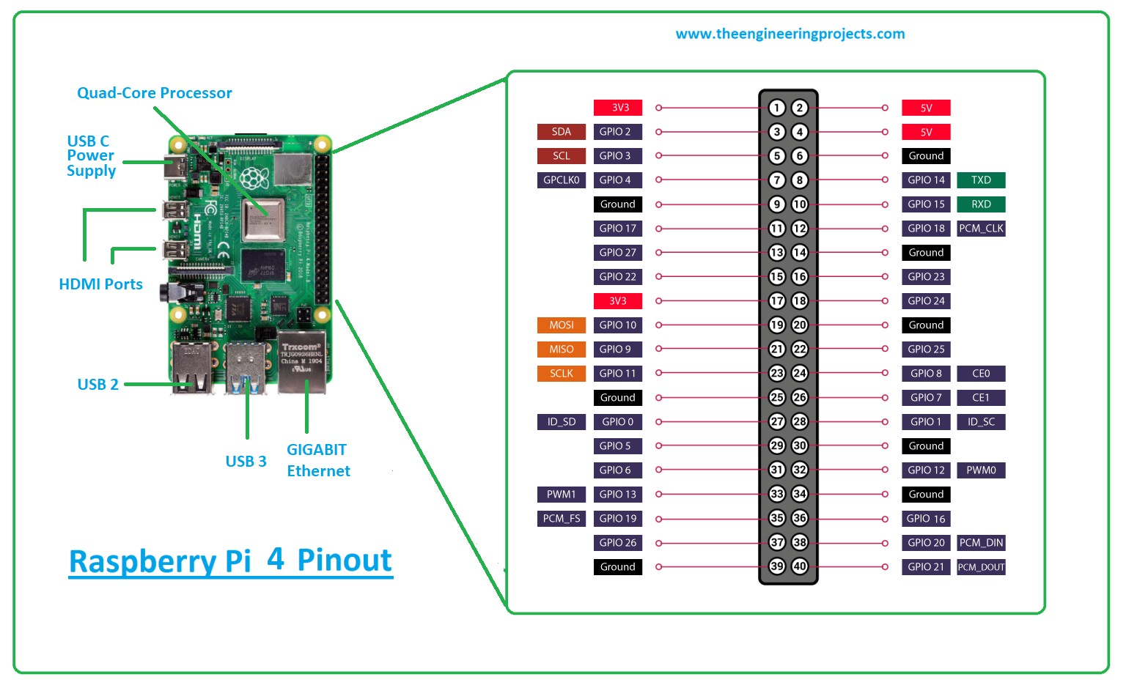
CONTROLLER
RASPBERRY PI 4 :

Slide 15
THANK YOU

